Slide 1
Project Overview
In this project, you will build a sophisticated Multi-Modal AI System designed to solve a massive enterprise headache: Manual Video Auditing. Instead of humans watching hours of footage to find regulatory violations, you will engineer an autonomous agent that does it in seconds.
You will act as a Cloud AI Architect. You will leverage Azure Video Indexer to ingest raw video files, extracting transcripts and OCR data. Using LangGraph, you will build a stateful orchestration pipeline that cross-references this video content against a database of complex compliance rules using RAG (Retrieval-Augmented Generation).
Crucially, this project focuses on "Production-Grade AI". You won't just generate answers; you will trace every step of the reasoning process using LangSmith and monitor the system’s health with Azure Application Insights, transforming unstructured video into structured, actionable JSON compliance reports.
Azure AI Ecosystem: Get hands-on experience with the full suite: Video Indexer, OpenAI, AI Search, and App Insights.
Why this Project?
Multi-Modal is the Future: Text-only RAG is becoming standard. Adding Video Processing puts you in the top tier of AI engineers.
"Black Box" Solved: By teaching LangSmith and App Insights, you show employers you know how to peek inside the "Black Box" of AI and make it reliable.
High-Value Use Case: Automated Compliance is a multi-billion dollar problem in Finance, Healthcare, and Media. This project builds a solution for that exact
market.
What you will Learn?
Multi-Modal AI: Master the workflow of processing Video, Audio, and Text in a single pipeline. LangGraph Orchestration: Learn to build complex, non-linear AI workflows that go beyond standard LangChain sequences.
Enterprise RAG: Implement RAG using the powerful Azure AI Search service.
LLM Observability: Gain a critical skill for senior engineers: using LangSmith to debug and optimize complex LLM applications.

Slide 2
Module
Project Introduction
Foundational Understanding of the project
Deep Dive into project understanding
Project Directory Structure
Project Setup
Integrating Azure Services - Part 1
Integrating Azure Services - Part 2
Core Logic
Defining LangGraph States
Defining LangGraph Nodes
Building Workflow code
Building Document Indexer
Building Video Indexer
Integration + Deployment + Monitoring
Triggering workflow pipeline
Checking Output and Langsmith Tracing
Integrating FAST API Backend and Open Telemetry
Final Execution
Checking Output on Azure Application Insights

Slide 3
Tech Stack & Tools
Cloud Platform: Microsoft Azure (Video Indexer, AI Search, OpenAI, App Insights)
Orchestration: LangGraph (Stateful Agents)
Observability: LangSmith (LLM Tracing), Azure App Insights (System Monitoring)
Model: GPT-4o
Language: Python

Slide 4
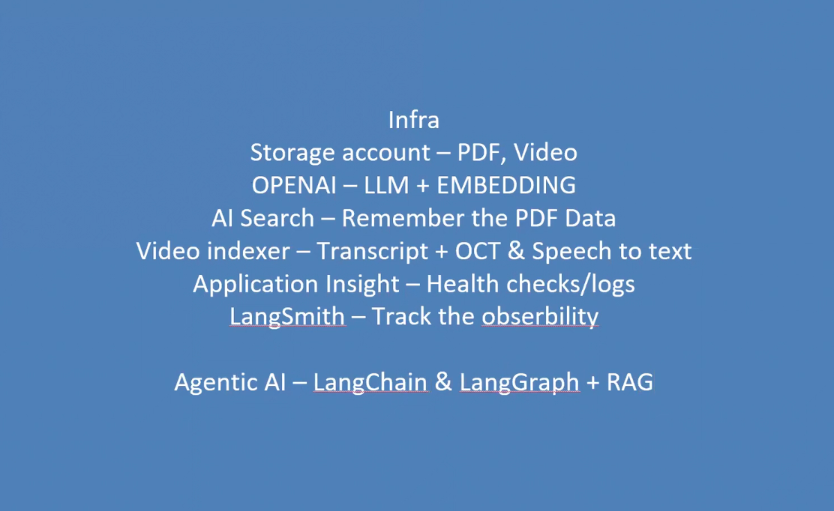

Slide 5
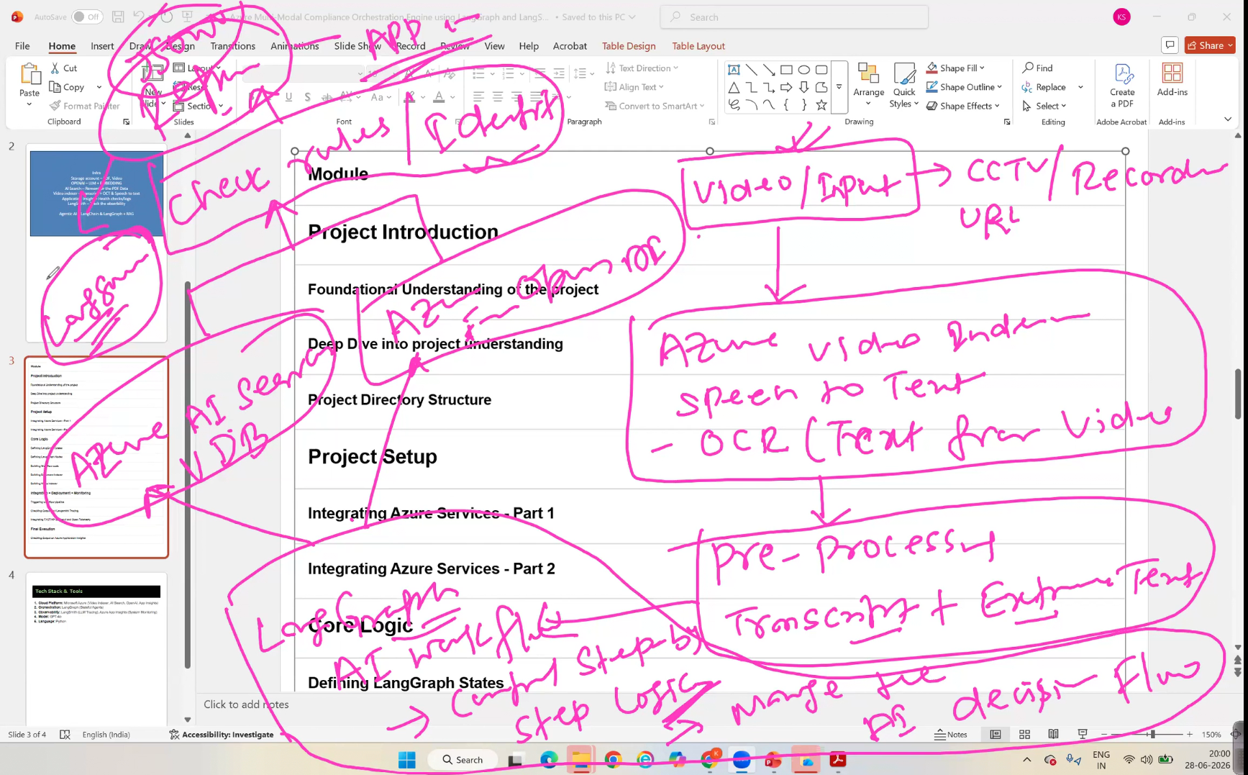

Slide 6
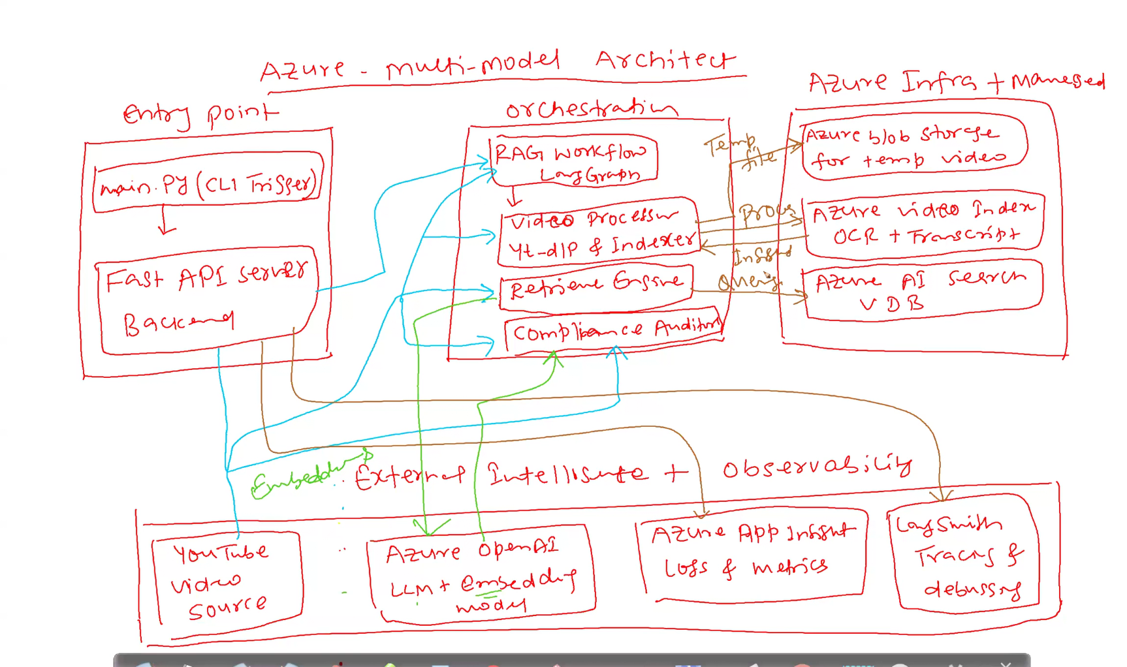

Slide 7
